Slide 1
Artificial Neural Network
報告人：陳昭維、林禹陞
日期: 02/18/22

Slide 2
Outline
Artificial Neural network
Training ANN model
Convergence issues

Slide 3
Outline
Artificial Neural network
Single-layer network
Multilayer neural network
Example
Training ANN model
Convergence issues

Slide 4
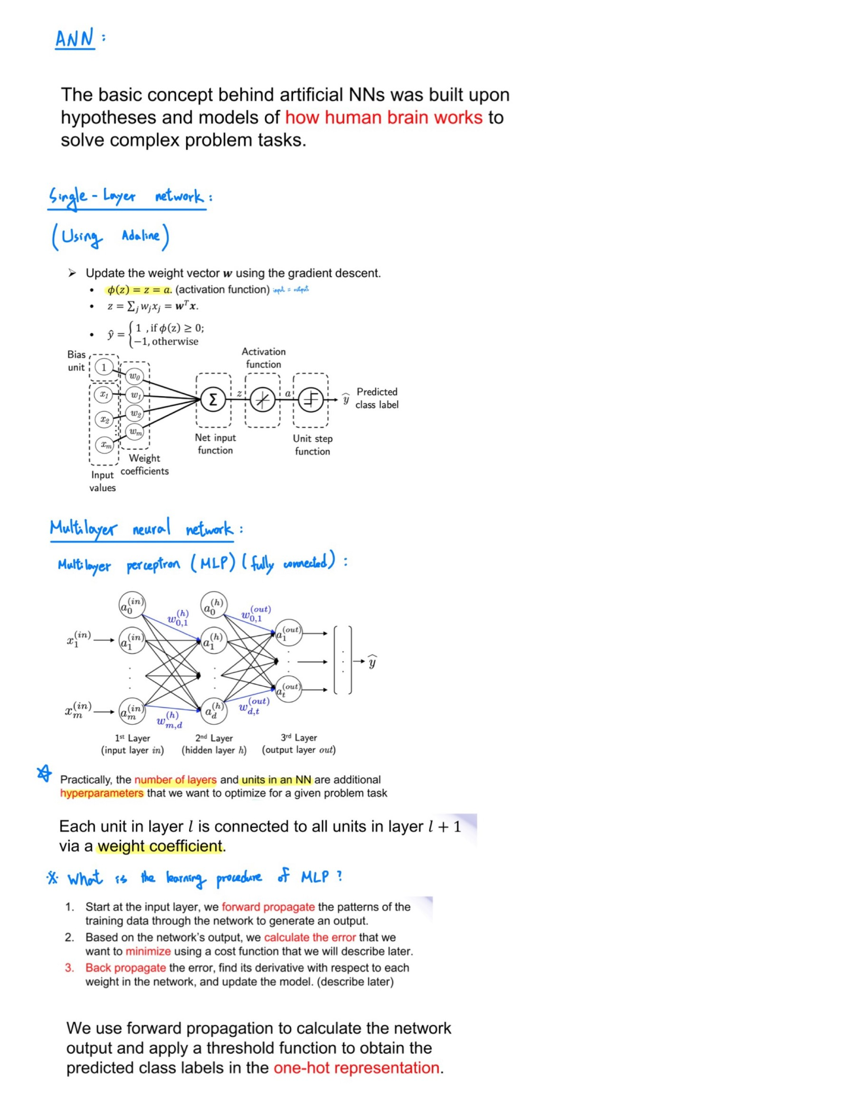
Introduction

Slide 5
Single-layer network

Slide 6
Multilayer neural network

Slide 7
The procedure of MLP

Slide 8
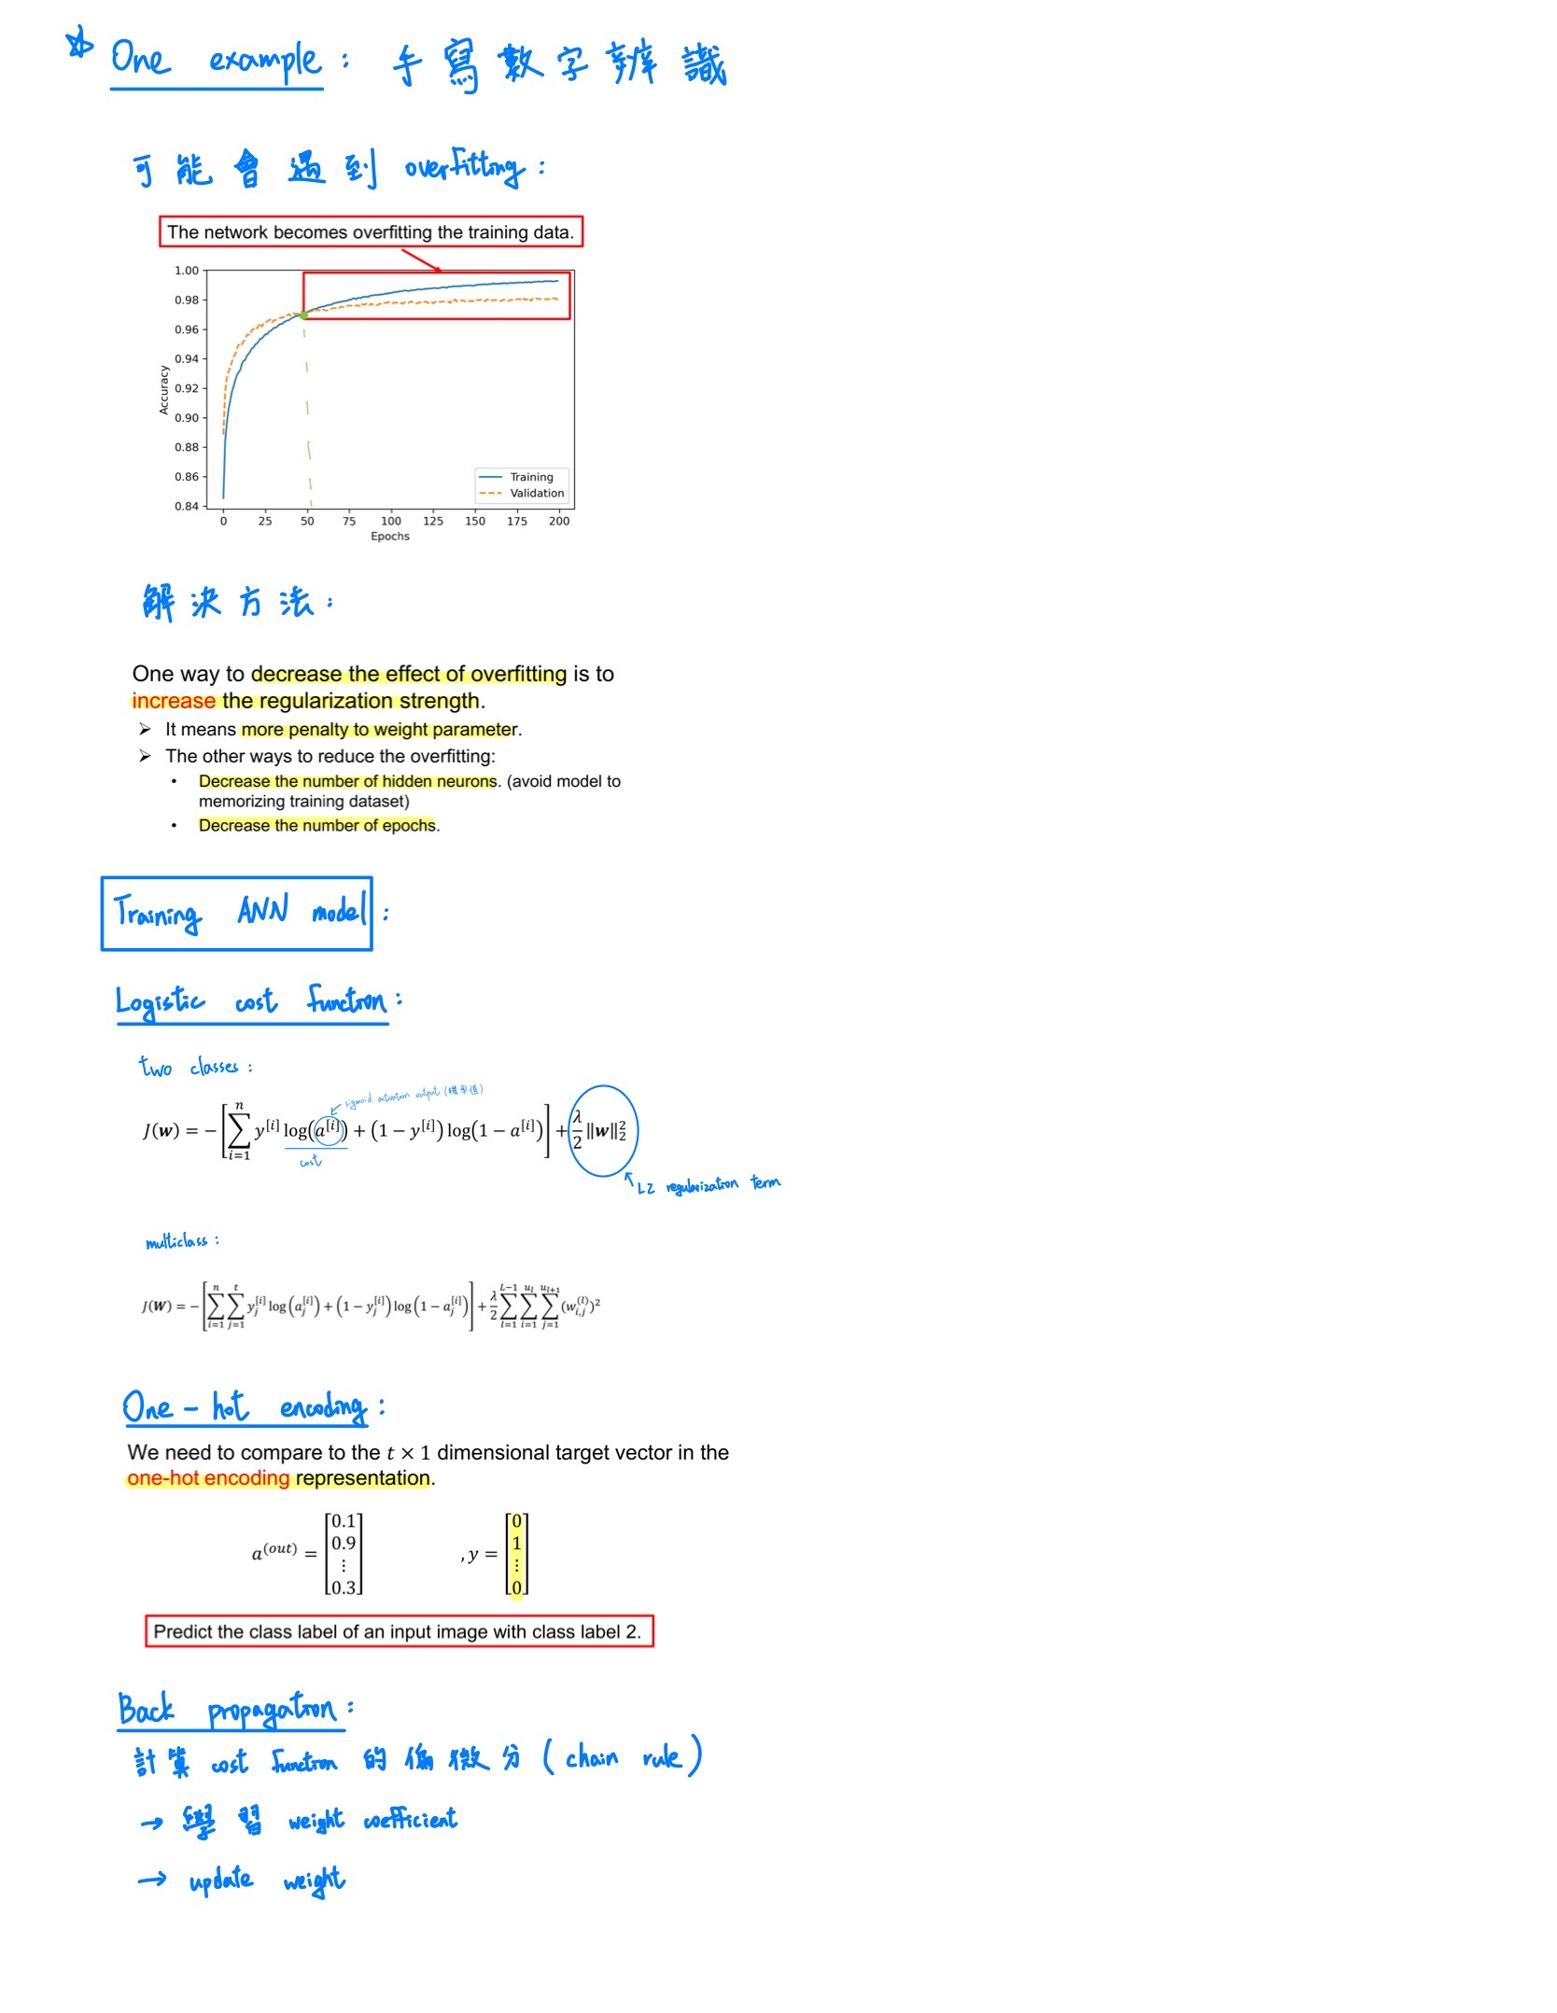
Example

Slide 9
Example

Slide 10
Outline
Artificial Neural network
Training ANN model
Logistic cost function
Back propagation
Convergence issues

Slide 11
Logistic cost function

Slide 12
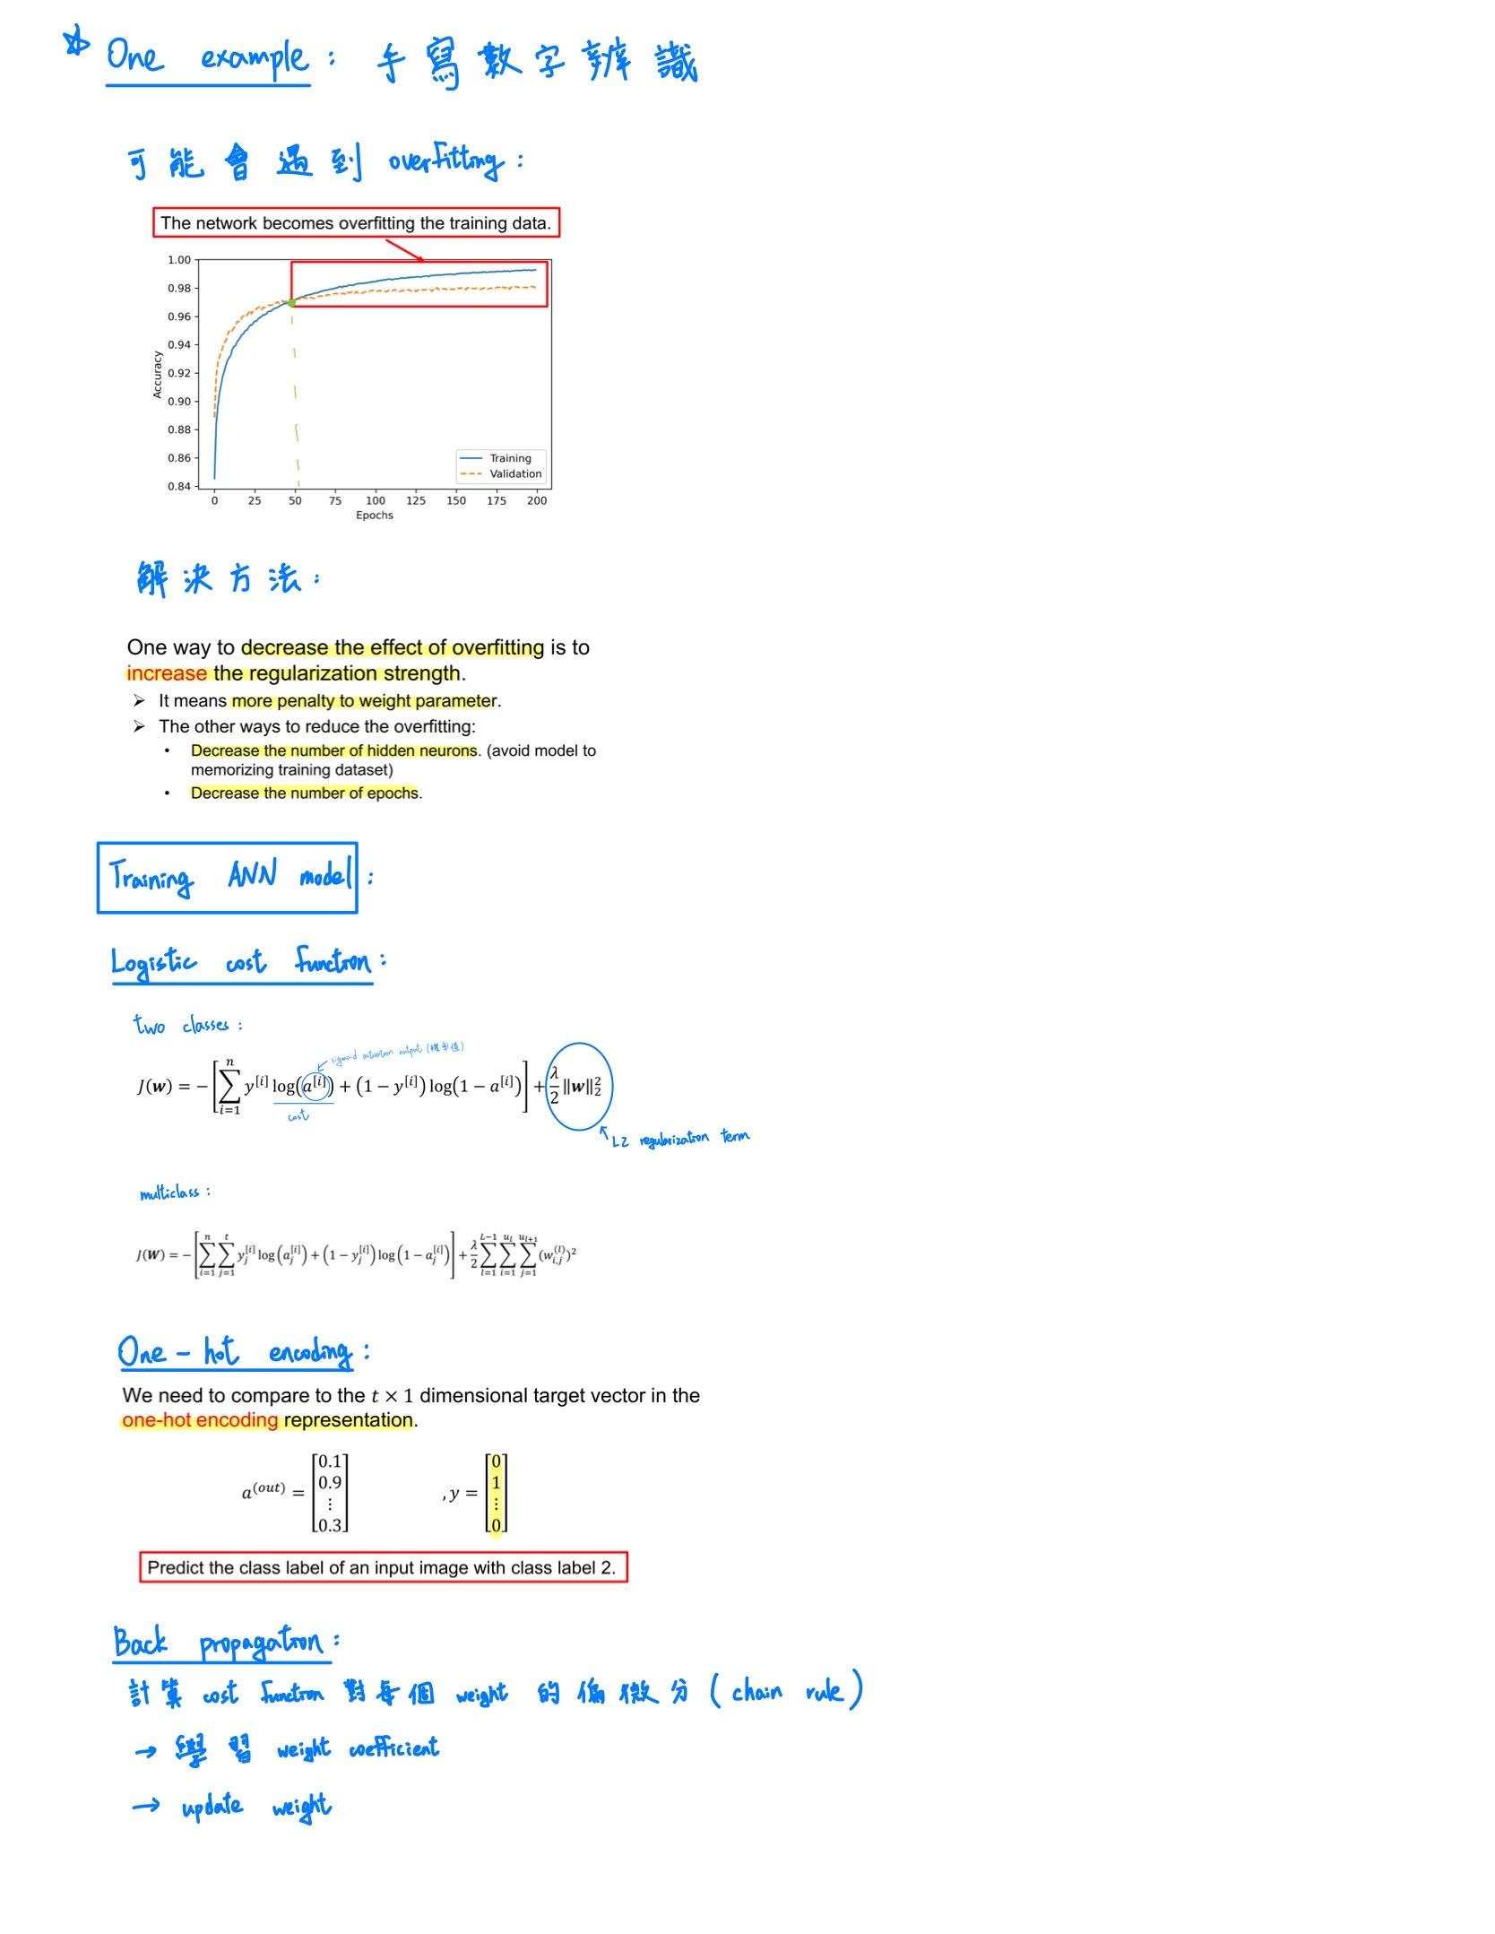
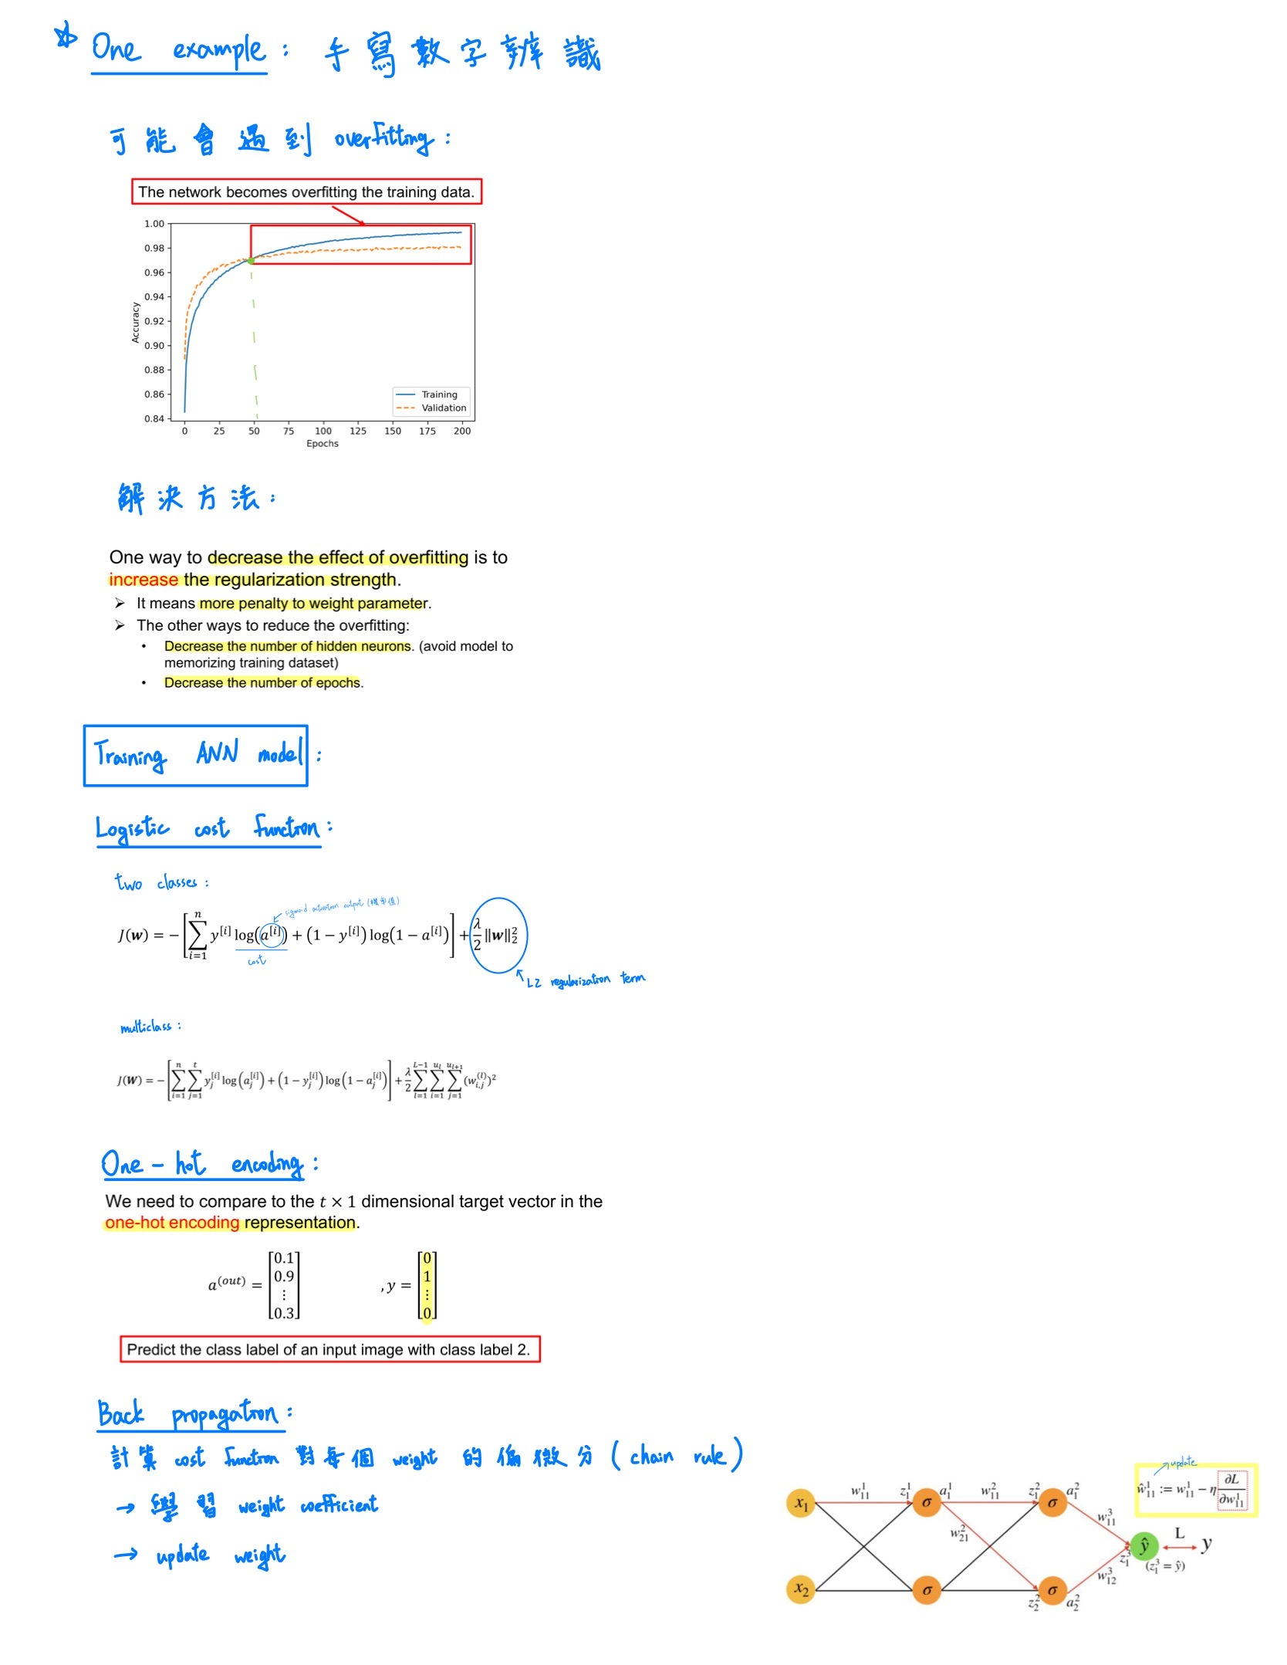
Back propagation
Main idea:

Slide 13
Outline
Artificial Neural network
Training ANN model
Convergence issues

Slide 14
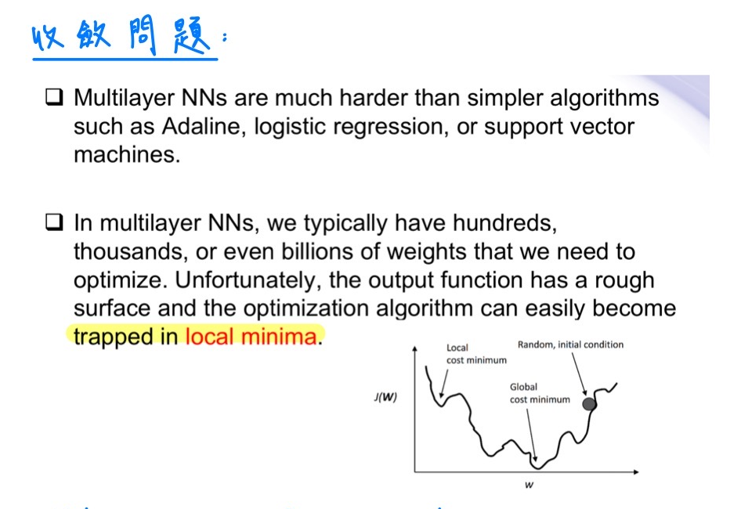
Convergence in neural networks

Slide 15
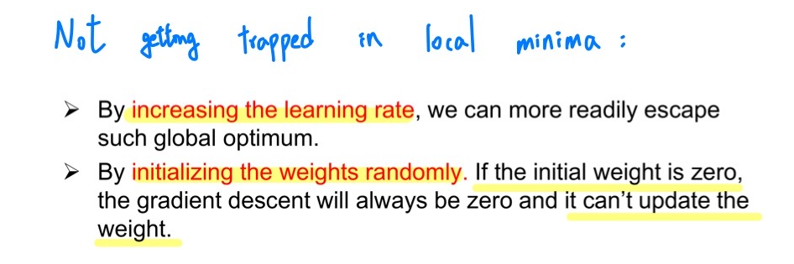
Convergence in neural networks

Slide 16
Recurrent Neural Network and LSTM application
報告人：陳昭維、林禹陞
日期: 02/18/22

Slide 17
Outline
Occasions of using RNN model
Application of RNN and extended model

Slide 18
Outline
Occasions of using RNN model
Sequential data with dependence
Representation of sequences and modeling.
RNN looping mechanism and computation.
Backpropagation through time
Difficulties and Solutions
Application of RNN and extended model

Slide 19
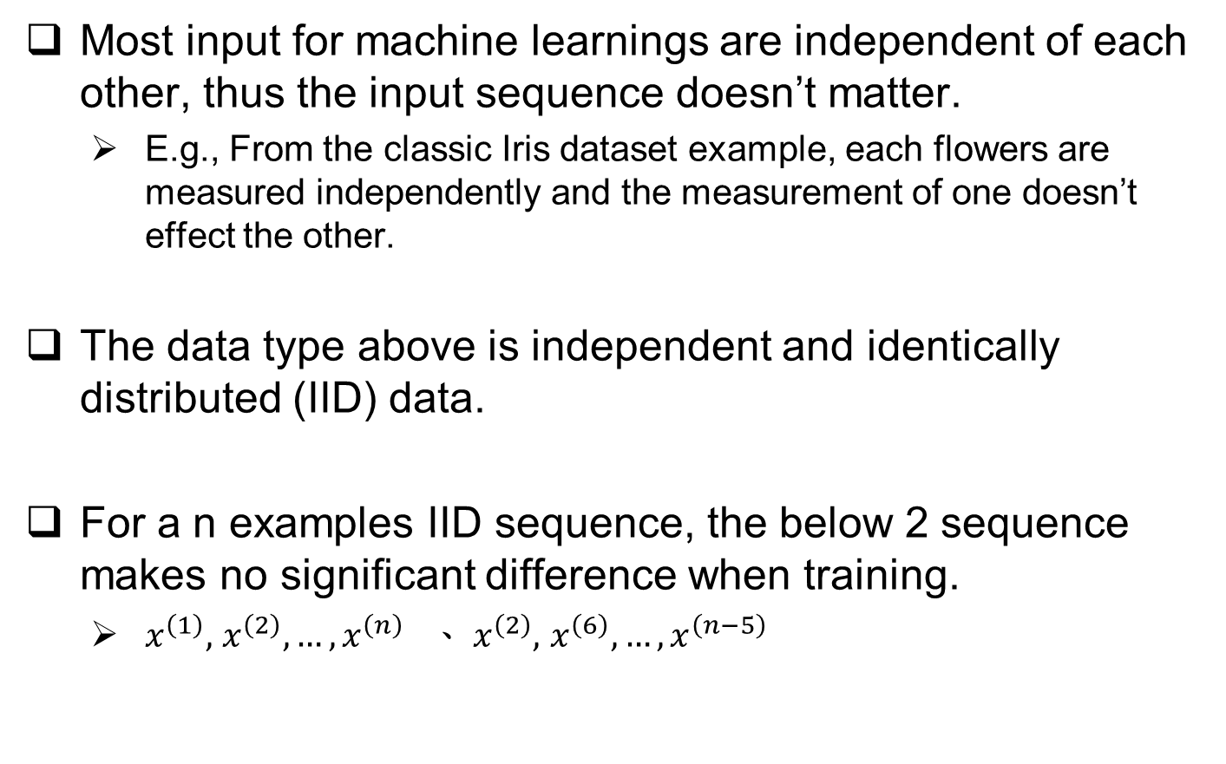
Sequential Data with Dependence
Most input for machine learnings are independent of each other, thus the input sequence doesn’t matter.
E.g., From the classic Iris dataset example, each flowers are measured independently and the measurement of one doesn’t effect the other.
The data type above is independent and identically distributed (IID) data.
For a n examples IID sequence, the below 2 sequence makes no significant difference when training.
$x^{\left(1\right)},$ $x^{\left(2\right)},…,x^{\left(n\right)} 、 x^{\left(2\right)},$ $x^{\left(6\right)},…,x^{\left(n−5\right)}$

Slide 20
Sequential Data with Dependence
But some output of network or system varies with the sequence of the input data even though the data might be constructed by the similar set.
E.g. Prediction of market price will be affected by previous stock price or global event, political event, etc.
Speech, voice recognition, paragraph and article reading will construct different meaning if the order is rearranged.
從 台北 第二月台 發車 抵達 高雄 第一月台 → 一張台北出發的票
從 高雄 第一月台 發車 抵達 台北 第二月台 → 一張高雄出發的票
Machine learning of Time-series data is often dealt with different approach.

Slide 21
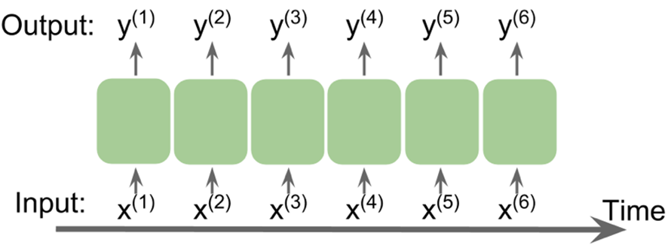
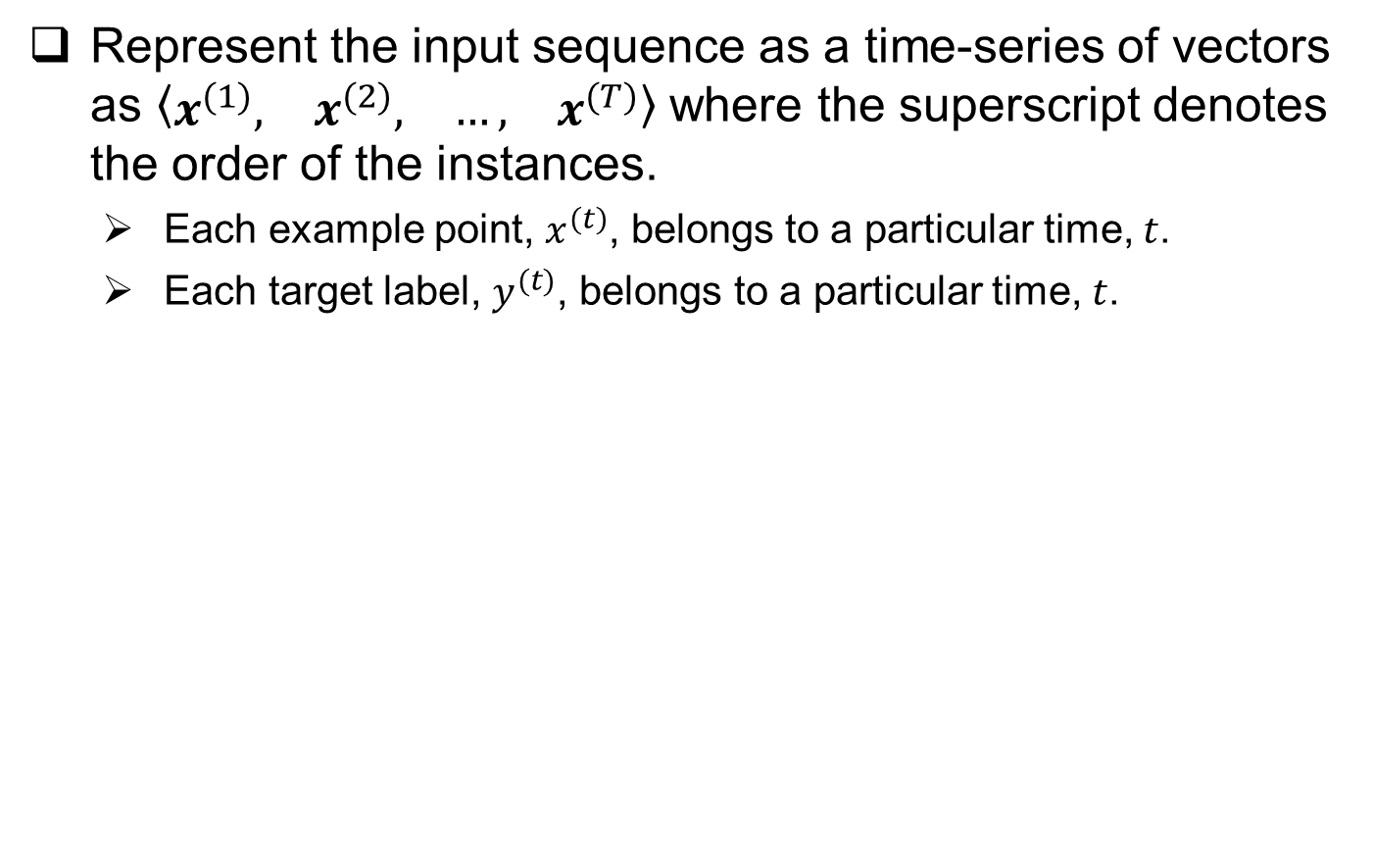
Representation of sequences and modeling
Represent the input sequence as a time-series of vectors as $\left\langle \begin{matrix}x^{(1)}, & x^{(2)}, & …, & x^{(T)}\end{matrix}\right\rangle$ where the superscript denotes the order of the instances.
Each example point, $x^{(t)}$, belongs to a particular time, $t$.
Each target label, $y^{(t)}$, belongs to a particular time, $t$.

Slide 22
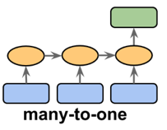
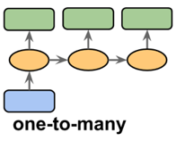
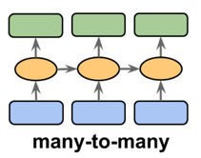
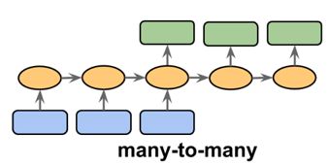
Representation of sequences and modeling
RNN is designed to be capable of using past information and current information to generate output.
Different types of model can be selected when dealing with different input and desired outputs.

Slide 23
Representation of sequences and modeling
Sentiment Analysis:
Using web crawl comment on PTT to generate single sentiment output for each unique input consists of words.
Pixel Analysis:
Using a single picture to generate a sentence or a description regarding to the picture.

Slide 24

Representation of sequences and modeling
Video classification: (synchronized)
Output each frame after sensor detects image or video.
Translation: (unsynchronized)
金融
科技
Financial
Technology

Slide 25
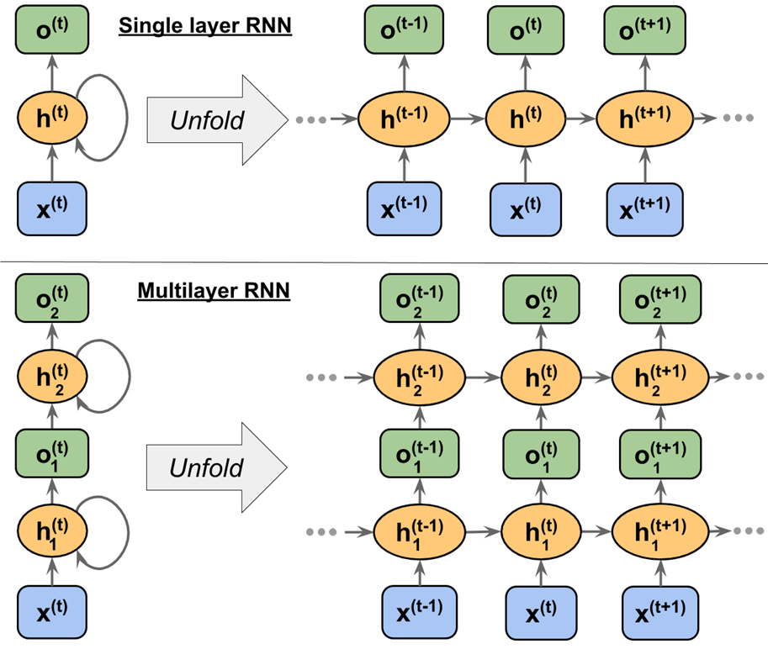
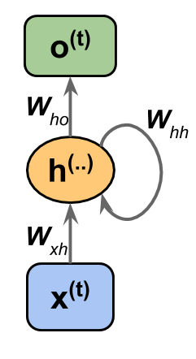
RNN Mechanism and Computation
RNN network has the capability of memorizing past event and combining the current information to generate output
A loop-back mechanism is needed in hidden-layer for the next time stamp.

Slide 26
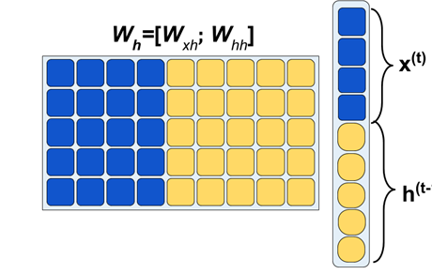
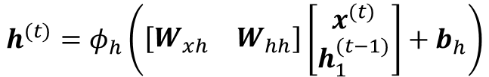
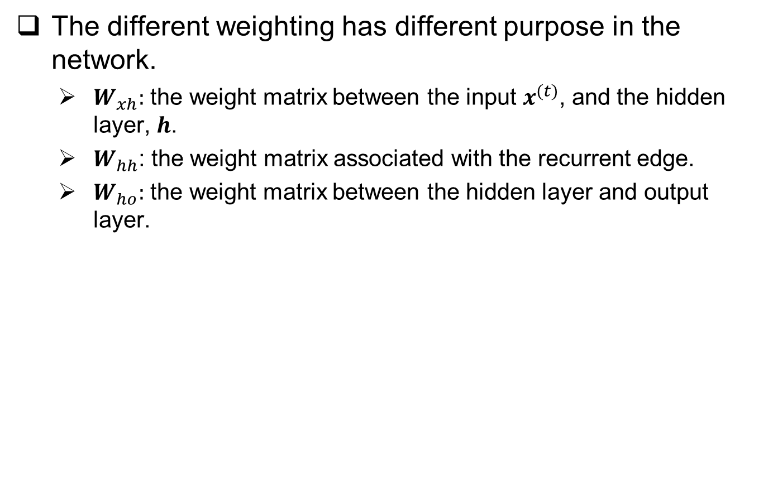
RNN Mechanism and Computation
The different weighting has different purpose in the network.
$W_{xh}:$ the weight matrix between the input $x^{(t)}$, and the hidden layer, $h$.
$W_{hh}$: the weight matrix associated with the recurrent edge.
$W_{ho}:$ the weight matrix between the hidden layer and output layer.
Present information
Past information

Slide 27
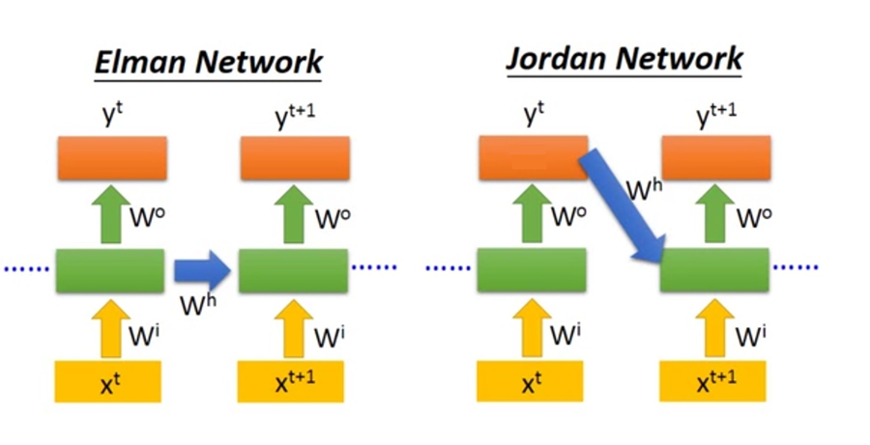
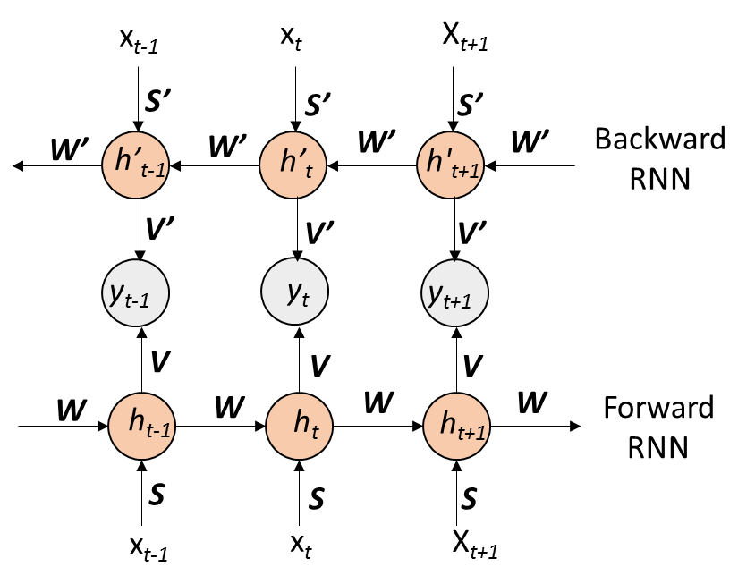
RNN Mechanism and Computation
There are different configuration of recurrent connection in RNN modeling.
Jordan network
Elman network
Bidirectional RNN

Slide 28

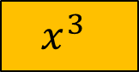
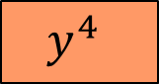
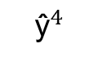
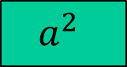
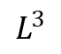
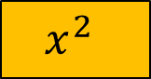
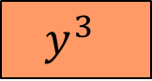
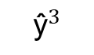
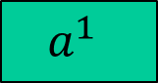
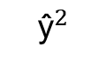
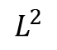
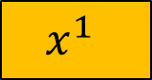
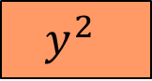
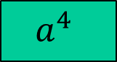
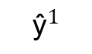
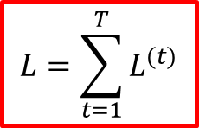
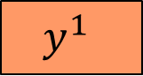
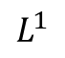
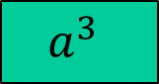
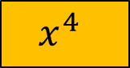
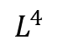
Backpropagation through time
A similar approach to normal NN, we can use back propagation to train the model, only that this time the loss accumulated through time needs to be considered.
$${\text{ŷ}}^{1}$$
$${\text{ŷ}}^{2}$$
$${\text{ŷ}}^{3}$$
$${\text{ŷ}}^{4}$$
$$L=\sum_{t=1}^{T}{L^{(t)}}$$
$$L^{1}$$
$$L^{2}$$
$$L^{3}$$
$$L^{4}$$
$$y^{1}$$
$$y^{2}$$
$$y^{3}$$
$$y^{4}$$
init
$$a^{1}$$
$$a^{2}$$
$$a^{3}$$
$$a^{4}$$
$$x^{1}$$
$$x^{2}$$
$$x^{3}$$
$$x^{4}$$

Slide 29
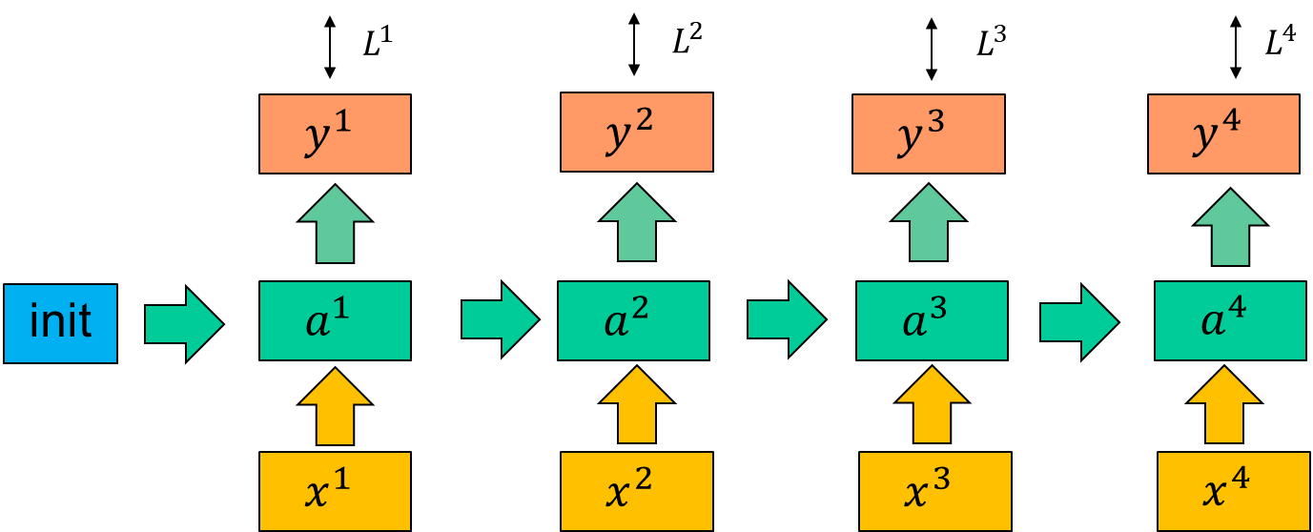

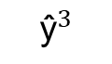
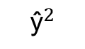
Backpropagation through time
$${\text{ŷ}}^{2}$$
$${\text{ŷ}}^{3}$$

Slide 30

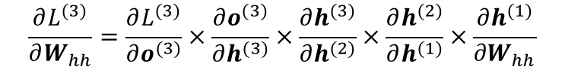
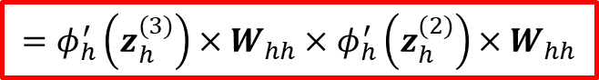
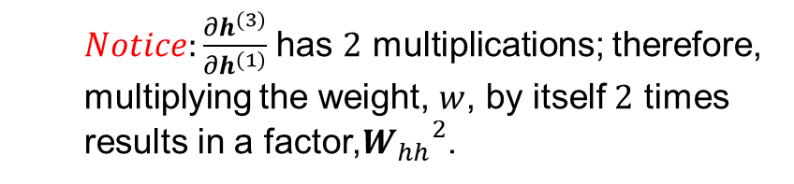
Backpropagation through time
$Notice:\frac{∂h^{(3)}}{∂h^{(1)}}$ has $2$ multiplications; therefore, multiplying the weight, $w$, by itself $2$ times results in a factor,${W_{hh}}^{2}$.

Slide 31
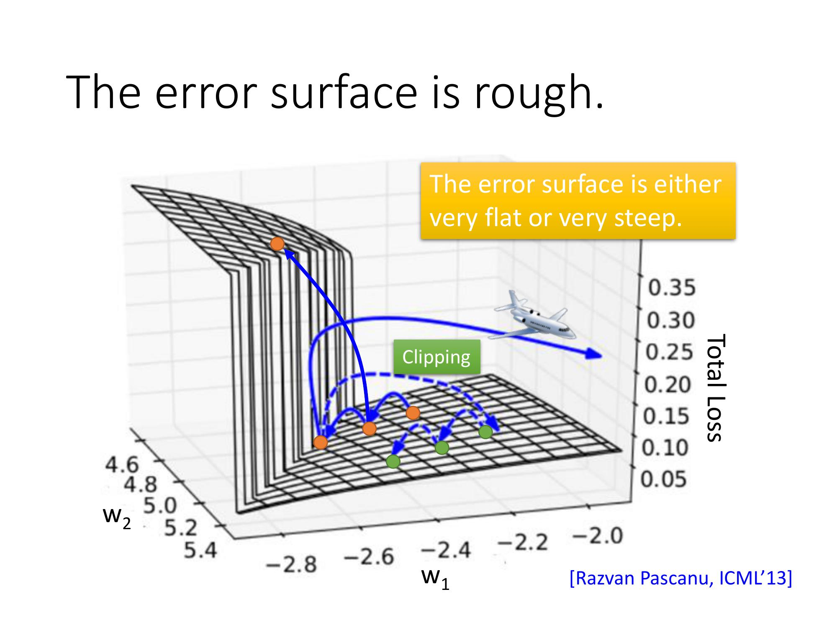
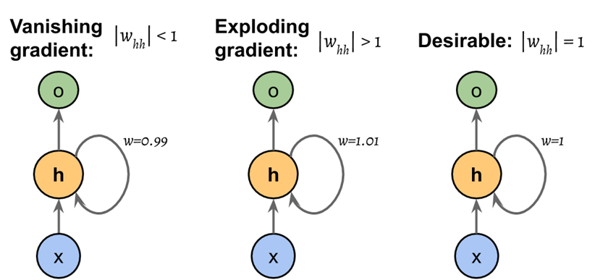
Difficulties and solutions
RNN is difficult to train in practice.
Weight multiplies for multiple times are being operated, thus causing gradient explosion or gradient vanishing.

Slide 32
Difficulties and solutions
There are some common solution to the problems.
Gradient clipping
this is introduced by setting a threshold value for gradient, so that it saturates at a cut-off value when exceeding it.
Long short-term memory cell (LSTM)
This is a complicated and modified model for RNN, and usually RNN refers to the method of using LSTM.
Truncated backpropagation through time
Limit time steps of propagation.
RMSProp
NAG

Slide 33
Outline
Occasions of using RNN model
Application of RNN and extended model
LSTM model and configuration

Slide 34
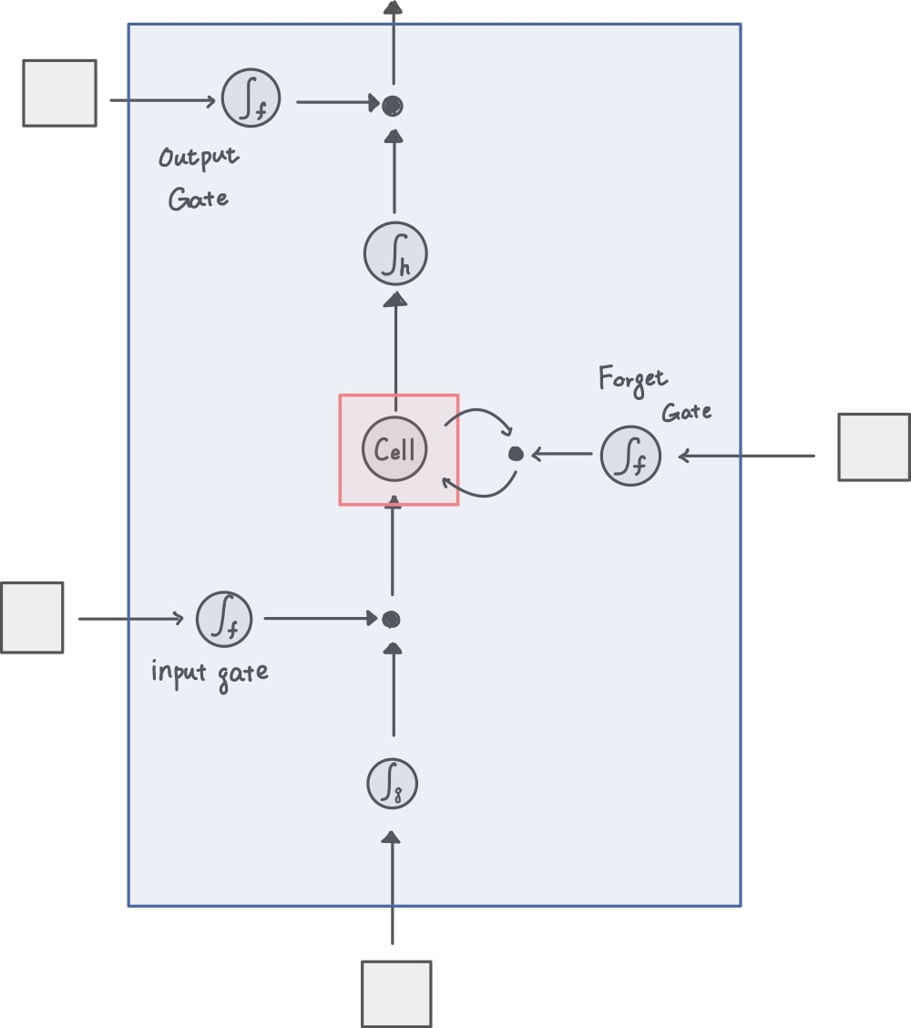

LSTM model and configuration

Slide 35


LSTM model and configuration
The LSTM cell has the ability to maintain different gate by input signal thus the weighting will be formatted in a certain rule or time stamp.
The activation function is usually a sigmoid/hyperbolic tangent function where the activation range is 0 to 1 or -1 to 1.

Slide 36











LSTM model and configuration
$${\text{σ}}_{f}$$
$h^{(t)}=o_{t}⨀σ⁡(C^{(t)})$.
$$o_{t}=σ\left(W_{xo}x^{(t)}+W_{ho}h^{(t−1)}+b_{o}\right)$$
$${\text{σ}}_{h}$$
$$f_{t}=σ\left(W_{xf}x^{(t)}+W_{hf}h^{(t−1)}+b_{f}\right)$$
$${\text{σ}}_{f}$$
$$C^{(t)}=\left(C^{(t−1)}⨀{ f}_{t}\right)⨁\left(i_{t}⨀{\tilde{C}}_{t}\right)$$
$${\text{σ}}_{f}$$
$${\tilde{C}}_{t}=σ⁡(W_{xc}x^{\left(t\right)}+W_{hc}h^{\left(t−1\right)}+b_{c})$$
$${\text{σ}}_{g}$$
$$i_{t}=σ\left(W_{xi}x^{(t)}+W_{hi}h^{(t−1)}+b_{i}\right)$$

Slide 37

LSTM model and configuration

Slide 38

Other configuration

Slide 39


Techniques to Vanishing gradient
Structurally constrained

Slide 40
END

